Slide 1



CAP 3104 Human and Technology Interaction Assignment 4 Group #9

Slide 2
Cohesive Teamwork
Working together as a cohesive and collaborative team
Dalese Russell: Project Manager: formatted some databasing code, did half of the icons, and majority of the presentation
Noah Magill: Graphic Artist, found icon software to use, helpful with questions, created icons, helped with presentation
Neeshmy Lopez: Documentation, created tables and inserts for database, added files to repository, helped with presentation
Alisa Crawford: Requirements Verification: databasing, created tables and inserts for database, made sure all requirements were enabled

Slide 3

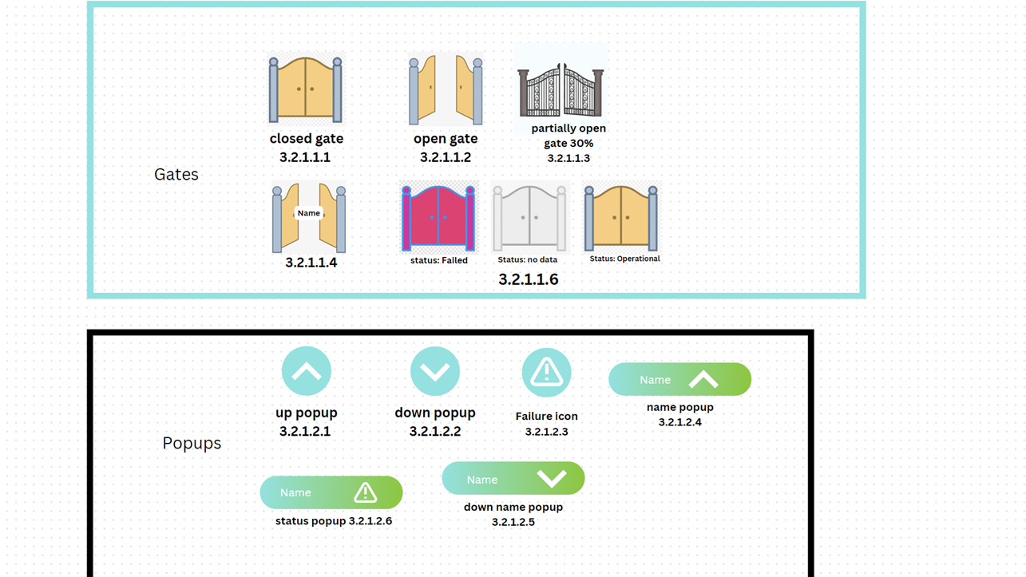
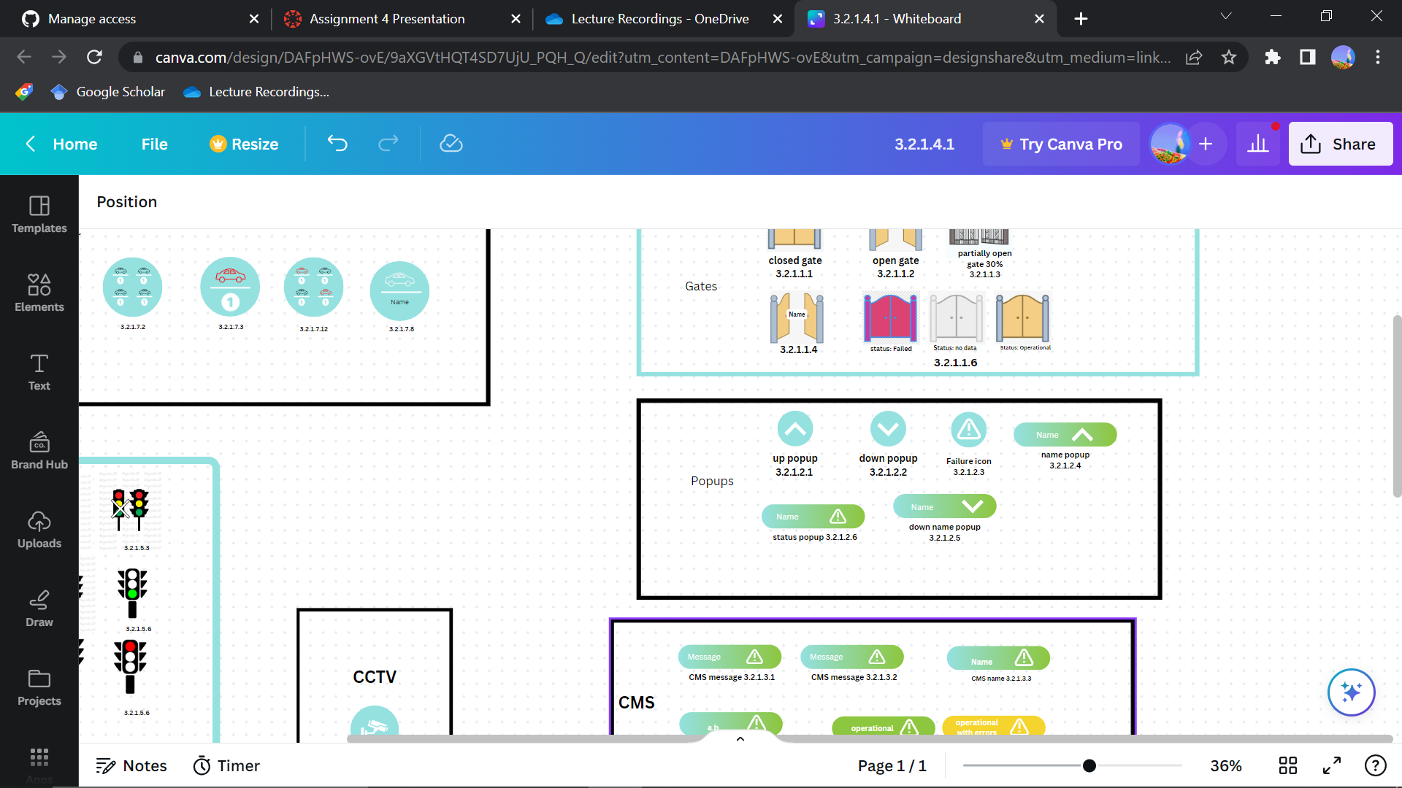
Images of Developed User Interface

Slide 4

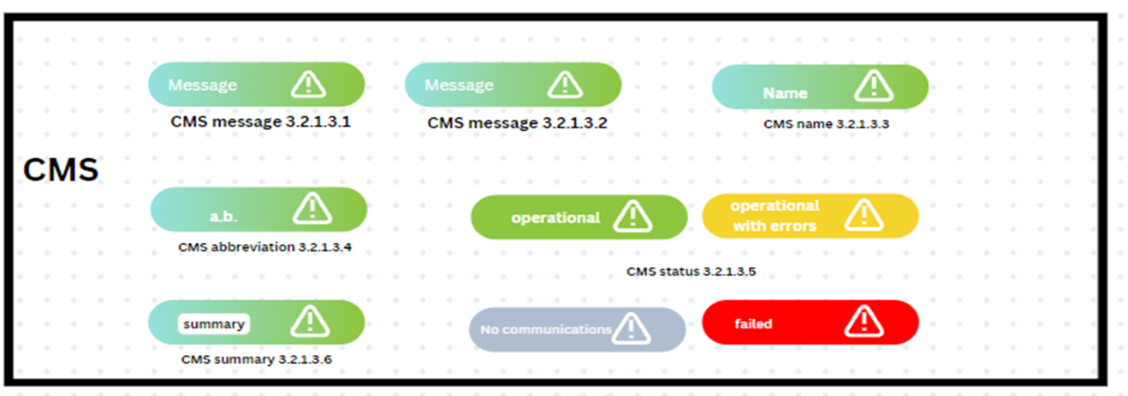
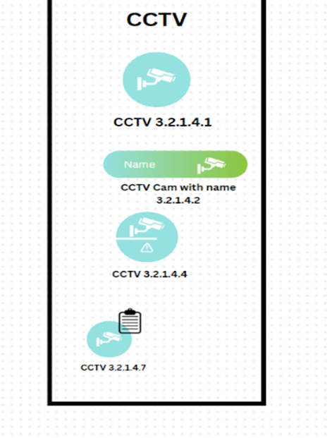
Images of Developed User Interface

Slide 5
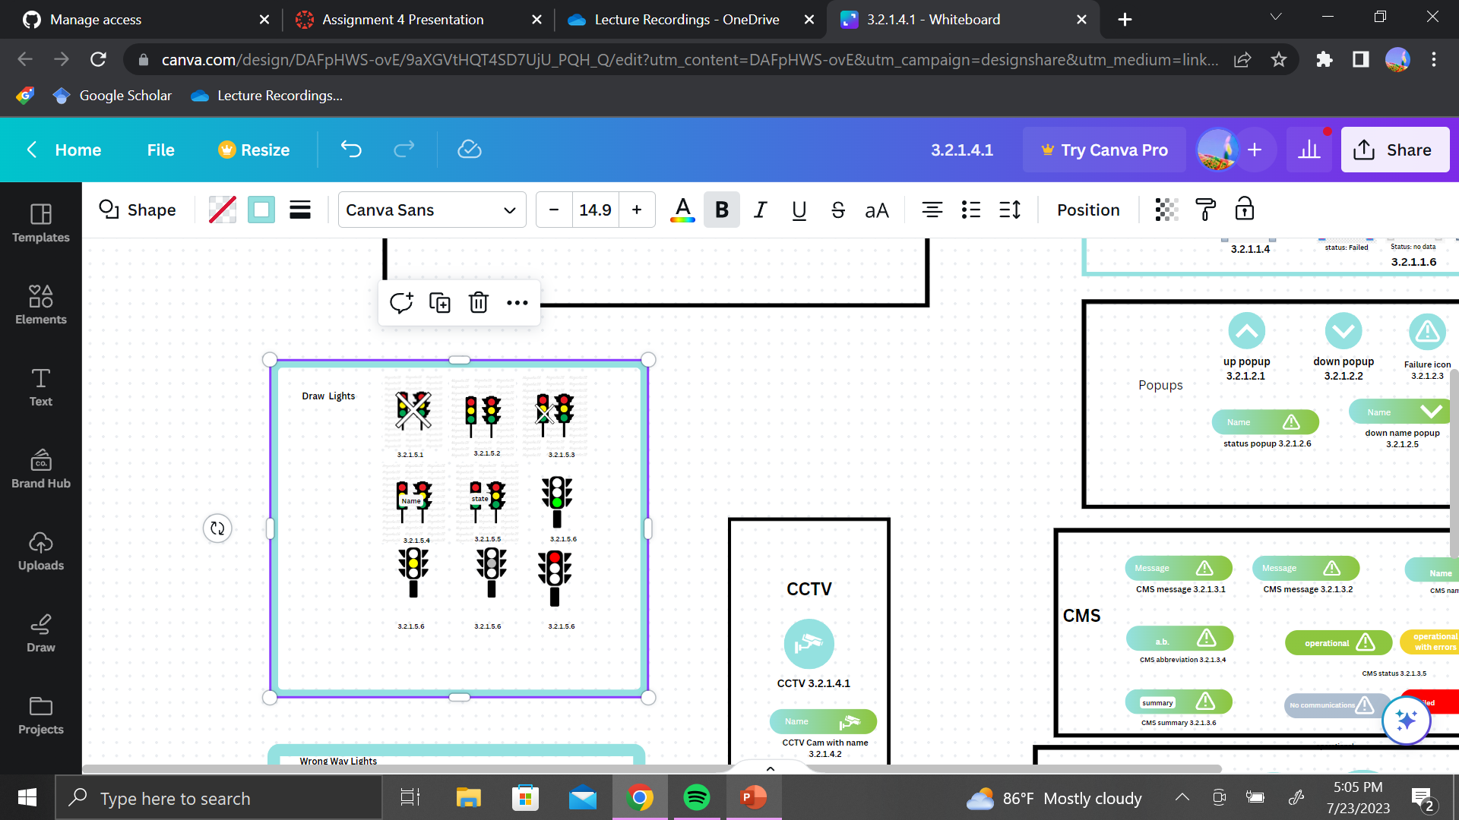
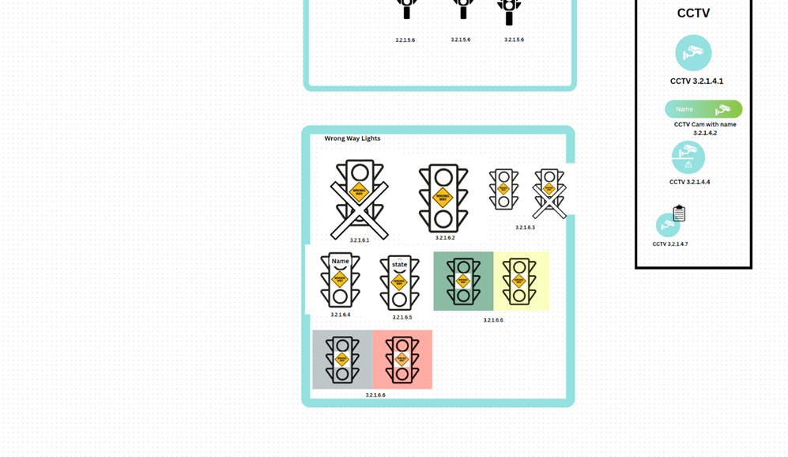
Images of Developed User Interface

Slide 6
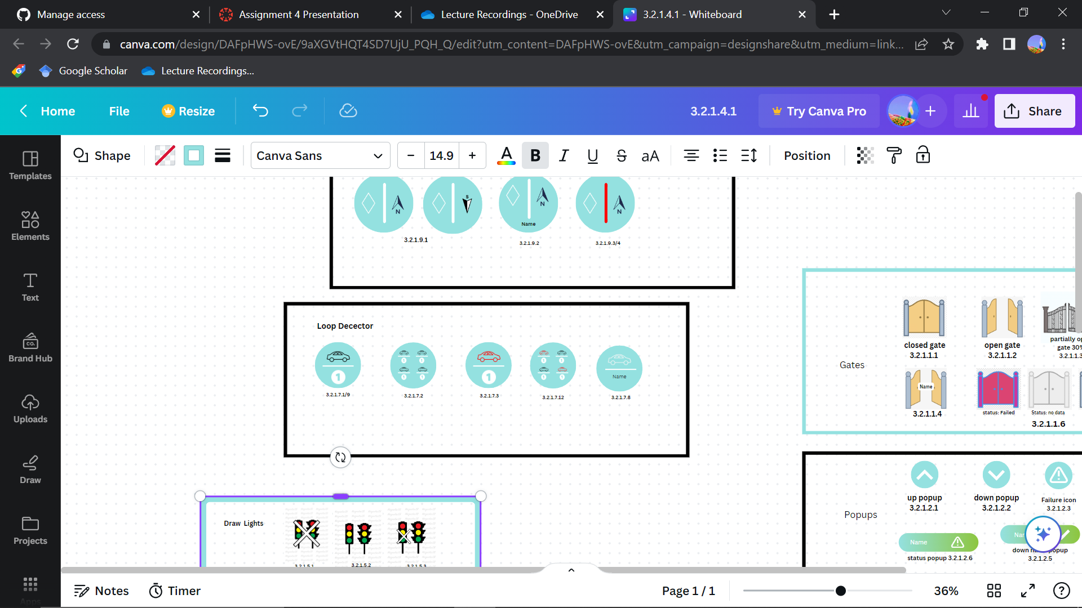
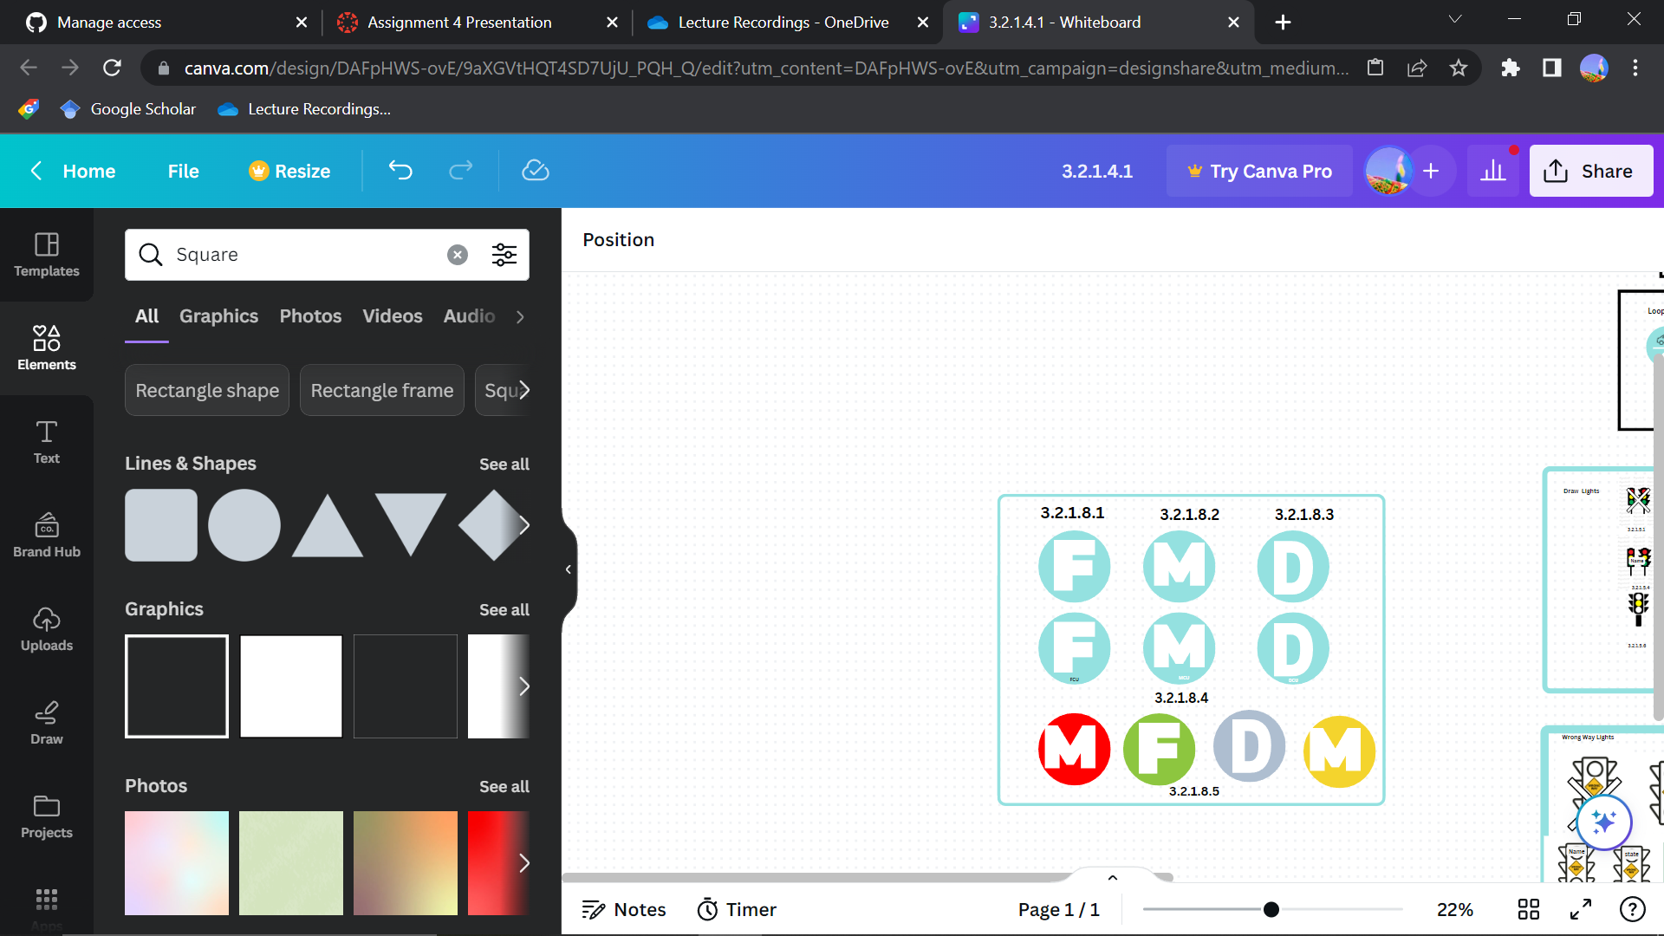
Images of Developed User Interface

Slide 7
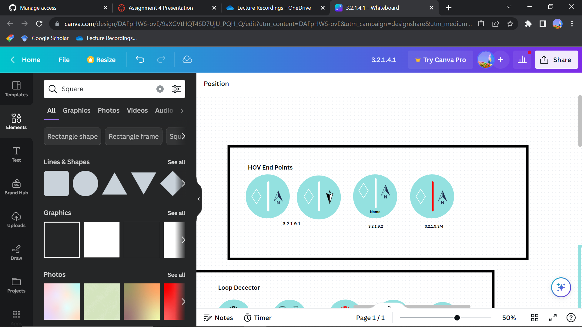
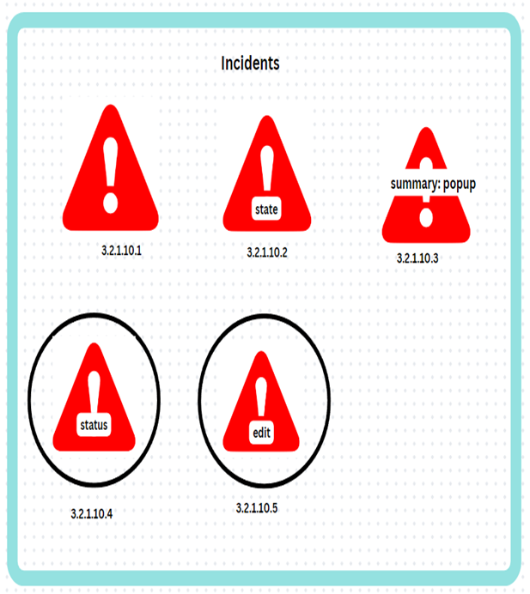
Images of Developed User Interface

Slide 8
Requirements Mapping of UI
3.2.1.1.1 An icon shall be selected to show a gate in a closed position.
3.2.1.1.3 A icon shall be selected during detailed design to show a gate in a partially open (15%) open position.
3.2.1.1.2 An icon shall be to show a gate in an open position.
15%
3.2.1.1.4 The gate icon shall be configurable to show the name of the gate with the icon.
3.2.1.1.6 The gate icon shall be configurable to show the status of the gate (operational, failed, or no data). The color of the gate icon shall be changed to show the status of the gate.

Slide 9
Requirements Mapping of UI
3.2.1.2.3 An icon shall be selected to indicate a failure status when some popups in a
group are in a “Down” position and some popups in the same group are in an “Up’ position
3.2.1.2.2 An icon shall be selected to indicate a group of popups in a “Down” or
entrance opened position
3.2.1.2.1 An icon shall be selected indicate a group of popups in an “Up” or entrance
closed position
3.2.1.2.4 The popup icon shall be configurable to display the name of the popup group
3.2.1.2.6 The popup icon shall be configurable to display the status of the popup group. The color of the icon
shall be changed to show the status of the popup group.
3.2.1.2.5 The popup icon shall be configurable to display the state of the popup group (up or down).

Slide 10

Requirements Mapping of UI
3.2.1.3.1 An icon shall be selected during detailed design to indicate changeable message signs
3.2.1.3.2 An icon shall be selected during detailed design to indicate a changeable message sign that is
displaying a message
3.2.1.3.3 The CMS icon shall be configurable to display the name of the sign with the icon.
3.2.1.3.4 The CMS icon shall be configurable to display an abbreviated message text with the icon
3.2.1.3.5 The CMS icon shall be configurable to display the status of the sign associated with the icon. The
CMS icon color shall represent the operational status of the CMS sign: green for operational, yellow
for operational with errors, gray for no communications and red for failed
3.2.1.3.6 if the operator moves the mouse over the CMS icon then a text window shall be displayed with a
summary of the operational state and status of the sign and the text of any message being displayed on
the sign.

Slide 11
Requirements Mapping of UI
3.2.1.4.1 An icon shall be selected to indicate a CCTV camera
3.2.1.4.2 The camera icon shall be configurable to show the name of the camera with the icon
3.2.1.4.4 The camera icon shall be configurable to show the status of the camera. The color of the camera icon
shall be changed to show the status of the camera.
3.2.1.4.7 The user shall be able to activate a device control window for the selected camera by right clicking on
the icon. The right click on the icon shall display a pop-up menu of available device actions from
which the user may select. This action shall cause a circle to be displayed over the camera icon for as
long as the device control window is displayed for that camera

Slide 12
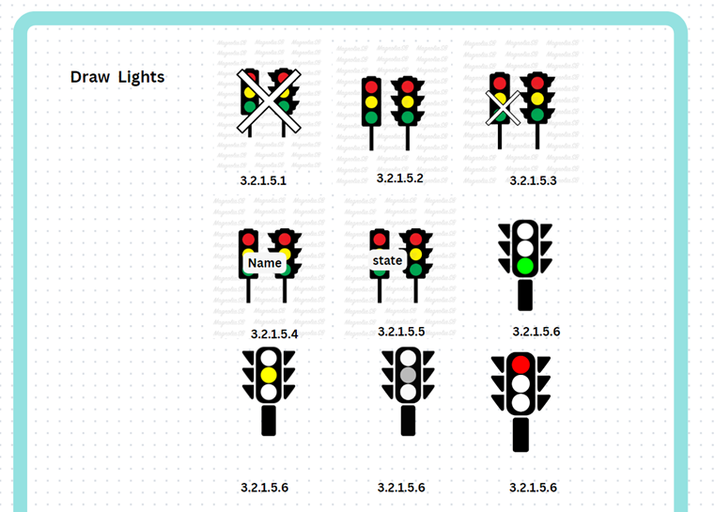
Requirements Mapping of UI
3.2.1.5.2 An icon shall be selected during detailed design to indicate a group of draw lights that are on.
3.2.1.5.3 An icon shall be selected during detailed design to indicate a group of draw lights where some are on and some are off.
3.2.1.5.1 An icon shall be selected during detailed design to indicate a group of draw lights that are off.
3.2.1.5.6 The draw light icon shall be configurable to display the status of the draw lights. The color of the draw light icon shall represent the status of the draw light: green for operational, yellow for operational with errors, gray for no communications and red for failed.
3.2.1.5.4 The draw light icon shall be configurable to display the name of the draw lights.
3.2.1.5.5 The draw light icon shall be configurable to display the state of the draw lights.

Slide 13
3.2.1.6.2 An icon shall be selected during detailed design to indicate a group of wrong way lights that are on.
3.2.1.6.1 An icon shall be selected during detailed design to indicate a group of wrong way lights that are off
3.2.1.6.3 An icon shall be selected during detailed design to indicate a group of wrong way lights where some are on and some are off.
3.2.1.6.4 The wrong way light icon shall be configurable to display the name of the draw lights
The wrong way light icon shall be configurable to display the status of the group of wrong way lights. The color of the wrong way light icon shall represent the status of the wrong way light: green for operational, yellow for operational with errors, gray for no communications and red for failed.
3.2.1.6.5 The wrong way light icon shall be configurable to display the state of the wrong way lights

Slide 14
Requirements Mapping of UI
3.2.1.7.3 The loop detector and group detector icons shall use color to indicate either speed, volume, or
occupancy is within a specified range or if no data is available from the detector or from all loop
detectors in a group
3.2.1.7.2 An icon shall be selected during detailed design to indicate a group of loop detectors.
3.2.1.7.1 An icon shall be selected during detailed design to indicate a loop detector
3.2.1.7.12
The detector loop icon shall be configurable to display the status of the loop detector or group of loop
detectors
3.2.1.7.8 The loop detector icon shall be configurable to display the name of the loop detector

Slide 15
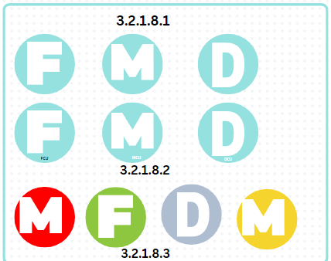
Requirements Mapping of UI
3.2.1.8.1 Icons shall be selected during detailed design to represent the FCUs and the DCU/MCUs.
3.2.1.8.3 The icons shall be configurable to show the status of the equipment at the site. The color of the icons
shall be changed to show the status of the equipment
3.2.1.8.2 The FCU icon and the DCU/MCU icon shall be configurable to show the name of the site with the
icon

Slide 16
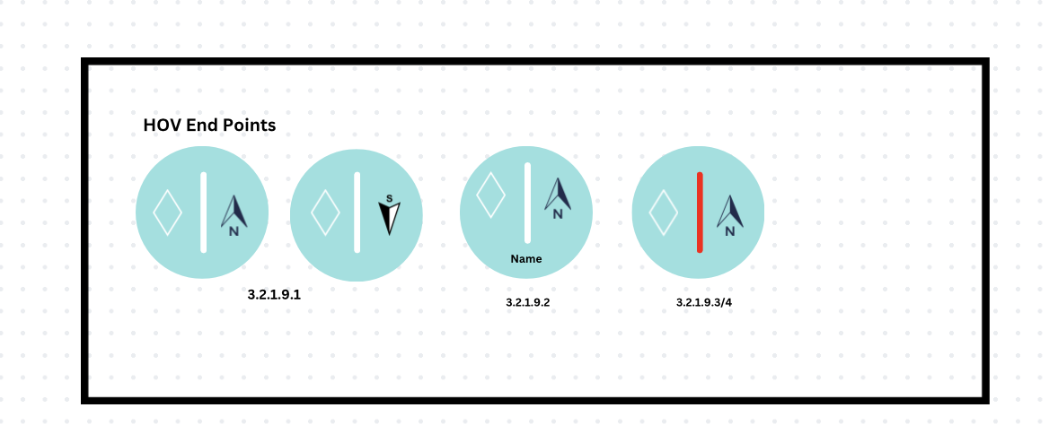
Requirements Mapping of UI
3.2.1.9.1 An icon shall represent the end point of the HOV lanes (N and S)
3.2.1.9.2 The icon shall be configurable to show the name of the end point
3.2.1.9.3 The end point icon shall be configurable to show the state of the end point
3.2.1.9.3 The end point icon shall be configurable to show the status of the end point. The color of the icon
shall be changed to show the status of the end point.

Slide 17
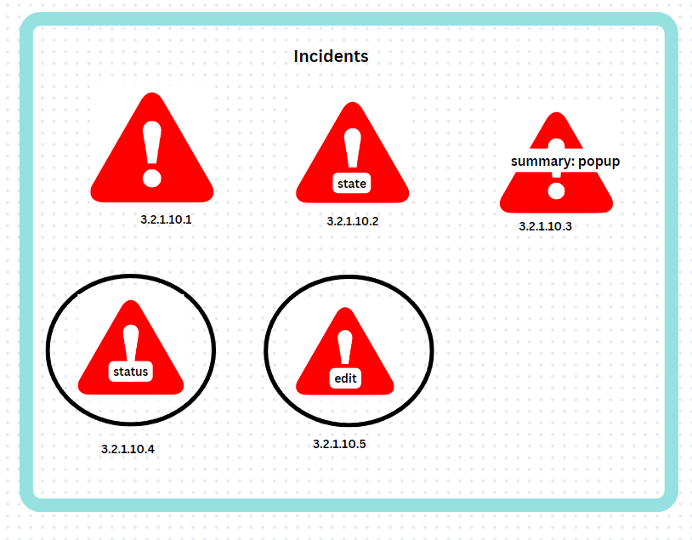
3.2.1.10.2 The incident icon shall be configurable to display the state of the incident.
3.2.1.10.3 When the operator moves the mouse over an incident icon a text window shall be displayed showing a summary of the incident state. The details of the summary state display will be defined in the GUI design document.
3.2.1.10.1 An icon shall be selected during detailed design to represent active incidents.
3.2.1.10.4 The operator shall be able to activate a detailed incident state window for the selected incident by double left clicking on the icon. This action shall cause a circle to be displayed over the incident icon for as long as the detailed device status window is displayed for that incident.
3.2.1.10.5The operator shall be able to activate an edit window for the selected incident by right clicking on the icon. This action shall cause a circle to be displayed over the incident icon for as long as the edit window is displayed for that incident.

Slide 18
HTI Discussion
The HTI concepts which were applied to the UI are the following:
Functionality, efficiency, and familiarity
When designing the UI, the group made sure to be as direct and simple as possible when establishing the icons. As you’ll see in the images above, the design aren’t things people may be unfamiliar with, so the meanings of the icons won’t be mistaken as easily. While designing we worked with alignment and contrast making sure the designs were easy on the eye, and the colors contrasts nicely. Through these principles of design, it is believed that we have established functionality, efficient design, and a familiar icon design that won’t lead to confusion or possible errors.

